Slide 1
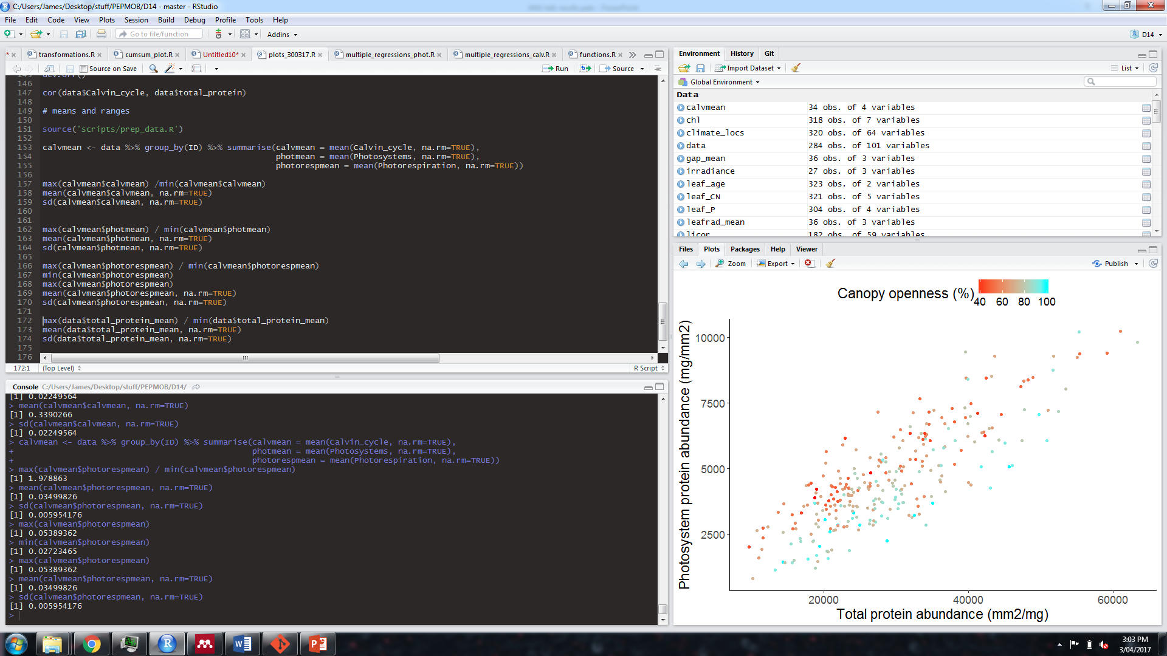
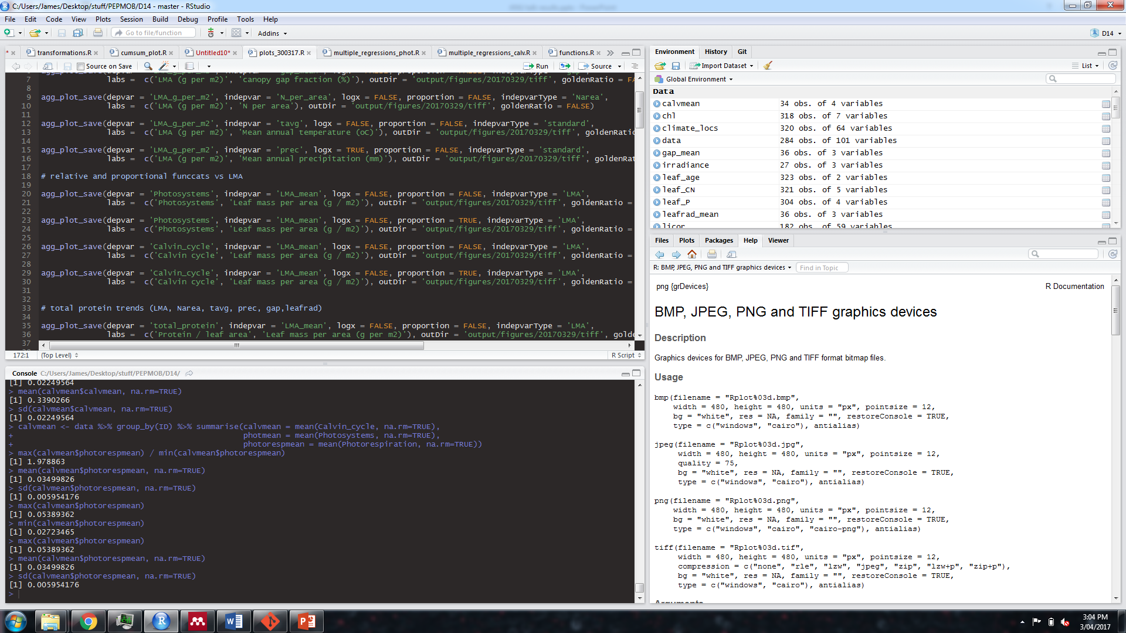
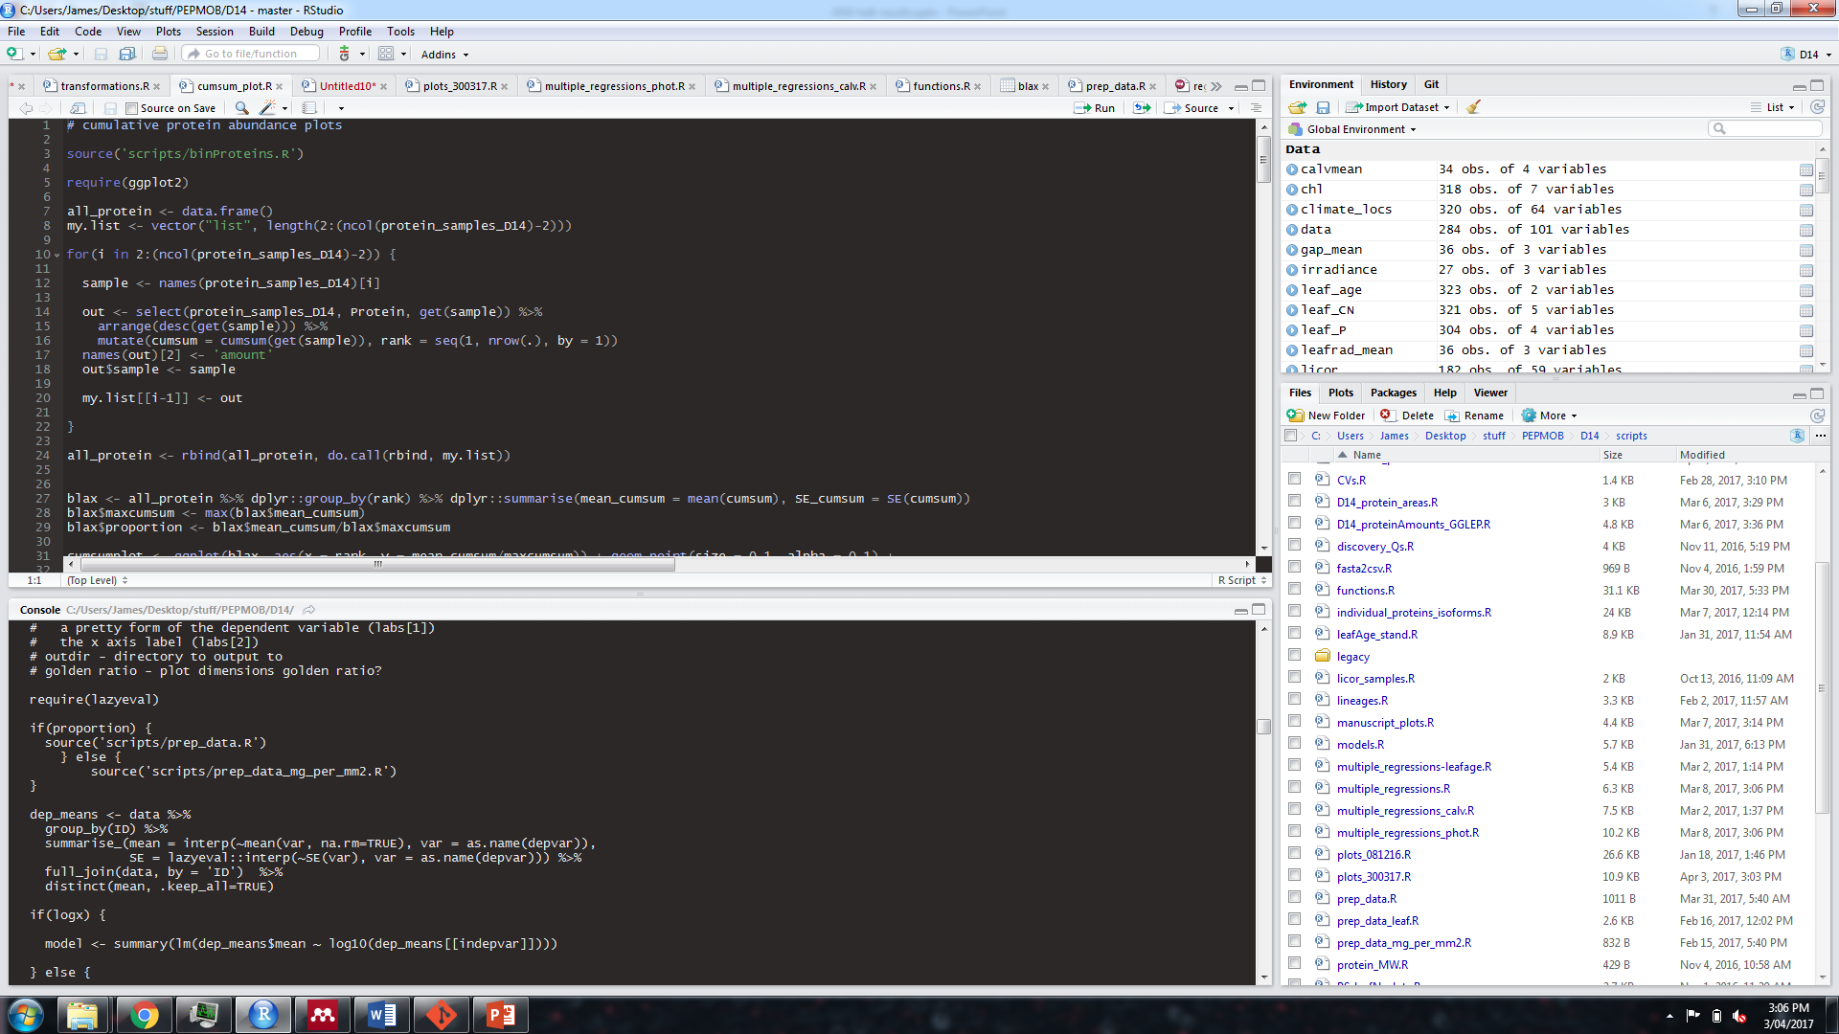
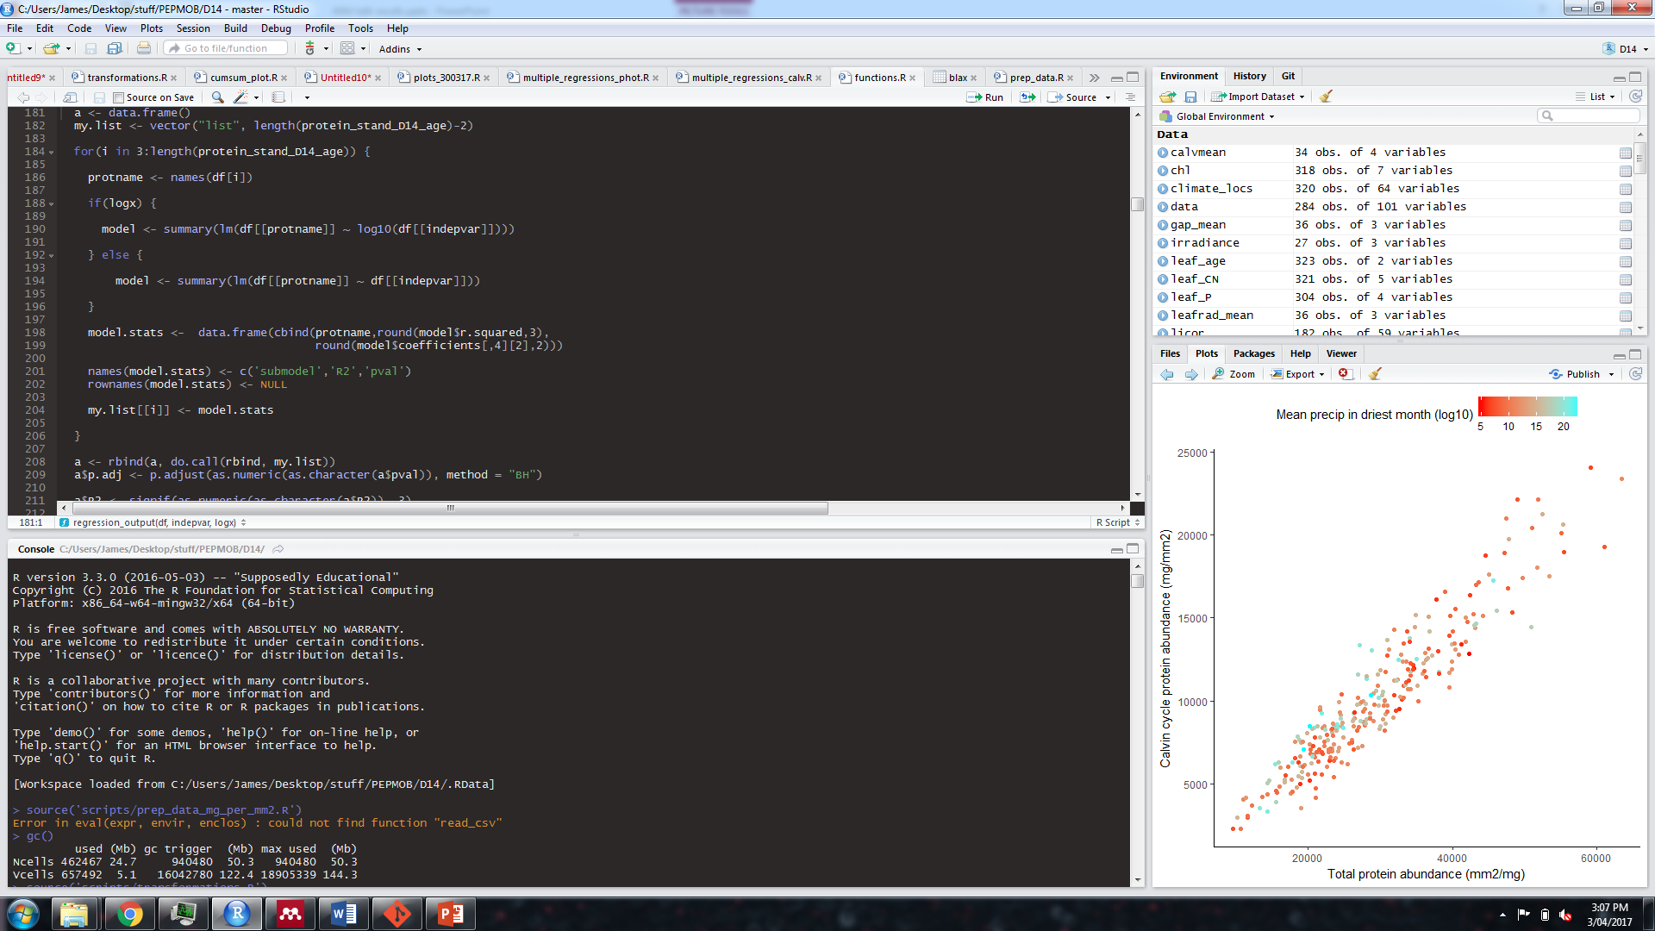

Slide 2
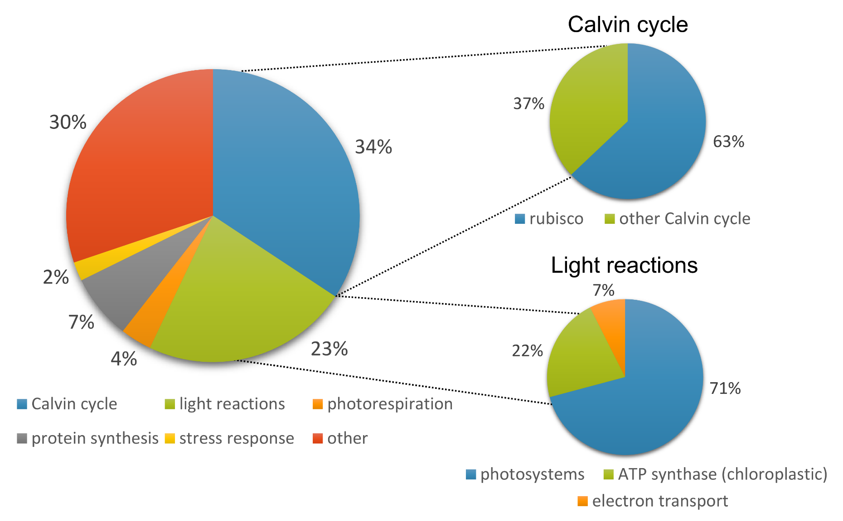
What’s in a leaf?
Leaf protein content ranges between 3 - 39 % of leaf dry mass (mean = 12 %, stdev = 4 %)
Notes:
Around 60% of the protein in our euc leaves was accounted for by photosynthesis proteins.
The mean abundances of the different functional categories shift around – as different samples have different proportions of protein within a given functional category at a given rank.
There are some gaps in the data here because of the cumulative summing code I used – it finds the average proportion of total protein for a given rank, and if there aren’t any proteins from that rank for a particular functional category then there’s a gap. Or just a point if there was just one sample with a protein at that rank.
The categories that have super abundant proteins – that would be Rubisco in the Calvin cycle and ATP synthase – start off being the most abundant but are gradually replaced as we increase the number of proteins.

Slide 3
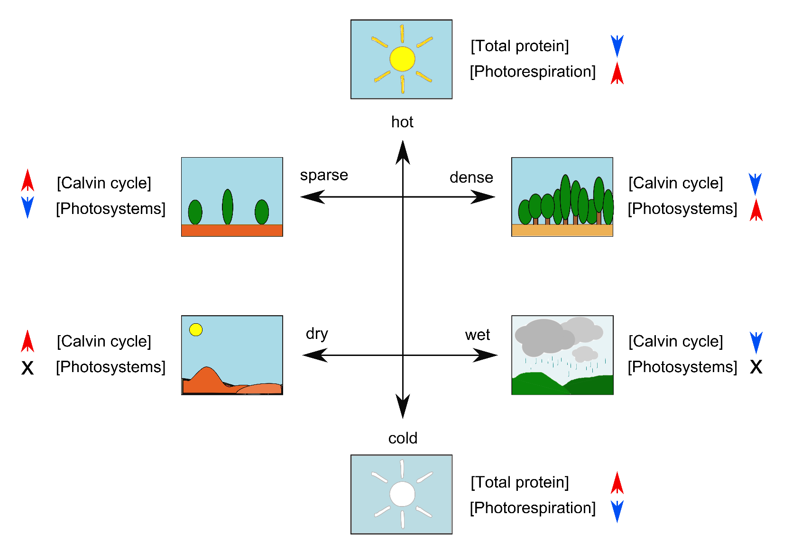
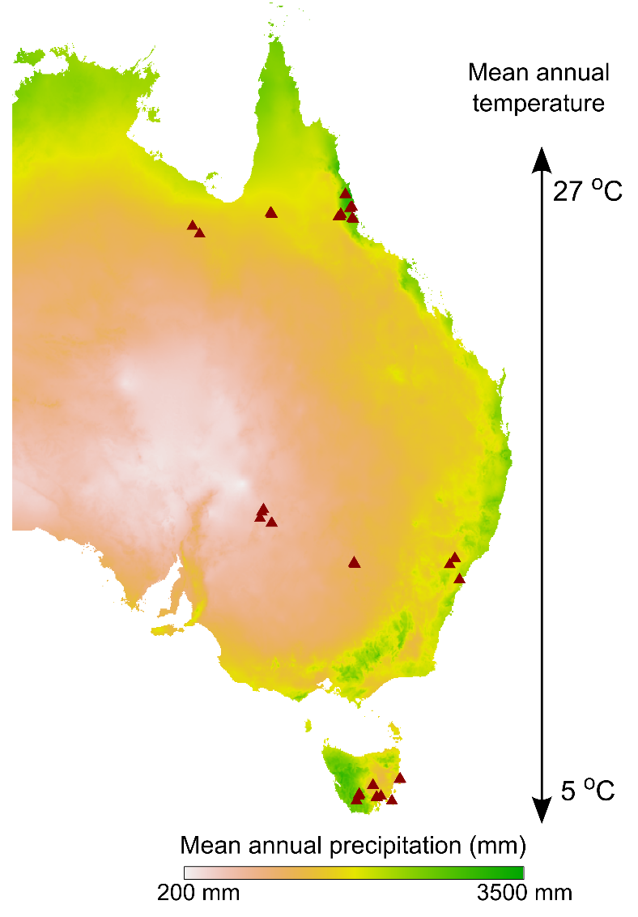
Optimising the photosynthetic apparatus
Co-ordination hypothesis: leaves should optimise protein allocation so that photosynthesis is co-limited by light capture and carboxylation capacity

Slide 4
Total protein content is greater at lower temperatures
p < 0.001, R² = 0.49, 85 % decline
p = 0.18
 | Min. | Max. | Mean | Std. dev. | Magnitude
Total protein (mg/mm²) | 17873 | 47639 | 29007 | 6550 | 2.7-fold
Photoresp. (proportion) | 0.027 | 0.054 | 0.035 | 0.006 | 2-fold

Slide 5


Total protein content is greater at lower temperatures
p < 0.001, R² = 0.49, 85 % decline
p = 0.18
 | Min. | Max. | Mean | Std. dev. | Magnitude
Total protein (mg/mm²) | 17873 | 47639 | 29007 | 6550 | 2.7-fold
Photoresp. (proportion) | 0.027 | 0.054 | 0.035 | 0.006 | 2-fold

Slide 6
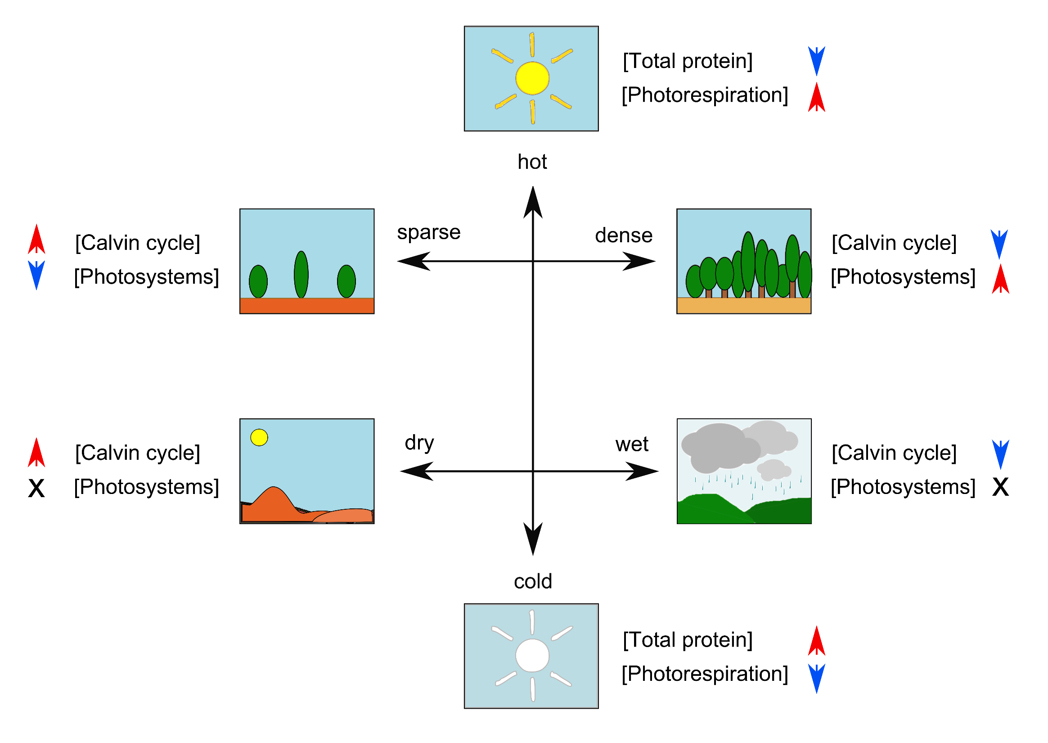

Slide 7
Allocation to photosystems is greater in low light
p < 0.001, R² = 0.43, 54 % decline
p < 0.001, R² = 0.37, 42 % decline
 | Min. | Max. | Mean | Std. dev. | Magnitude
Photosystems (proportion) | 0.09 | 0.23 | 0.16 | 0.03 | 2.5-fold
Notes:
Disentangling precip effect – if you look at precip over just the last year, there’s a much weaker correlation. Could mean that we’re really interested in time averaged effect on vegetation structure and light evnrio

Slide 8
Allocation to photosystems is greater in low light
p < 0.001, R² = 0.43, 54 % decline
p < 0.001, R² = 0.37, 42 % decline
 | Min. | Max. | Mean | Std. dev. | Magnitude
Photosystems (proportion) | 0.09 | 0.23 | 0.16 | 0.03 | 2.5-fold
Notes:
Disentangling precip effect – if you look at precip over just the last year, there’s a much weaker correlation. Could mean that we’re really interested in time averaged effect on vegetation structure and light evnrio

Slide 10
Trends in proportional abundance of Calvin cycle proteins
p = 0.19
p =0.02, R² = 0.16, 8 % increase
p = 0.07
 | Min. | Max. | Mean | Std. dev. | Magnitude
Calvin cycle (proportion) | 0.29 | 0.38 | 0.339 | 0.023 | 1.3-fold

Slide 11
Environmental trends in abundance of Calvin cycle proteins
p = 0.19
p =0.02, R² = 0.16, 8 % increase
p = 0.07
 | Min. | Max. | Mean | Std. dev. | Magnitude
Calvin cycle (proportion) | 0.29 | 0.38 | 0.339 | 0.023 | 1.3-fold

Slide 12
Room to move? Variation in proportional allocation
r = 0.82
r = 0.95
 | Min. | Max. | Mean | Std. dev. | Magnitude
Photosystems (proportion) | 0.09 | 0.23 | 0.16 | 0.03 | 2.5-fold
Calvin cycle (proportion) | 0.29 | 0.38 | 0.339 | 0.023 | 1.3-fold
Notes:
Photosystem abundance tracks total protein abundance less tightly than Calvin cycle abundance does. Leaves have more scope to alter proportional investment in photosystem proteins than Calvin cycle proteins.
Optimisation of carboxylation capacity more likely to be achieved by altering total leaf protein. One way to do this is by changing leaf mass per area

Slide 13
Influence of leaf anatomy on protein abundance
p = 0.88
p < 0.001, R² = 0.26
p < 0.001, R² = 0.31
p = 0.01, R² = 0.20
p = 0.15
Notes:
Leaves don’t produce more photosystem proteins as they become thicker, but they do produce more Calvin cycle proteins (and pretty much every other category of protein). Suggests that carboxylation capacity is added by leaf thickening but there is no effect on light capture.

Slide 14
Environmental trends in leaf mass per area
p = 0.01, R² = 0.19
p < 0.001, R² = 0.21

Slide 15
Environmental trends in leaf mass per area
p = 0.01, R² = 0.19
p < 0.001, R² = 0.21

Slide 16
Summary
The bulk of leaf protein is associated with photosynthesis
Leaves adjust proportional protein allocation to photosystem proteins in response to light availability
Environmental factors have only a marginal influence on proportional abundance of Calvin cycle proteins
Optimisation of carboxylation capacity is likely achieved by altering leaf anatomy and the total amount of protein per leaf area

Slide 17
Where to next?
Comparative work using data from Acacia and the Proteaceae
Molecular stoichiometry and abundance relationships between proteins and protein functional groups
Responses of other protein functional groups across environmental gradients
Parameterising systems-level models of photosynthesis and terrestrial biosphere models
Identifying isoforms of interesting photosynthesis enzymes with atypical abundance profiles

Slide 19
Effect of temperature on Cytochrome b6f (electron transport)
p < 0.001, R² = 0.35

Slide 20
Correlation matrix of environmental variables
 | Canopy openness | Irradiance | Mean annual temp. | Mean annual precip.
Canopy openness | 1 | 0.85 | 0.2 | 0.55
Irradiance | 0.85 | 1 | 0.61 | -0.5
Mean annual temp. | 0.2 | 0.61 | 1 | 0.16
Mean annual precip. | -0.55 | -0.5 | 0.16 | 1

Slide 21
